Slide 1
UNIT-1,PART-2
Introduction to Relational Model
Faculty- A.Sirisha

Slide 2
Outline
Structure of Relational Databases
Database Schema
Keys
Schema Diagrams
Relational Query Languages
The Relational Algebra
Notes:
1

Slide 3

Example of a Instructor Relation
attributes
(or columns)
tuples
(or rows)

Slide 4
Attributes
Each attribute of a relation has a name.
The set of allowed values for each attribute is called the domain of the attribute
Attribute values are (normally) required to be atomic; that is, indivisible.
Domain is said to be atomic if all its members are atomic
The special value null is a member of every domain. Indicated that the value is “unknown”
The null value causes complications in the definition of many operations
  We shall ignore the effect of null values in our main presentation and consider their effect later
Notes:
E.g. the value of an attribute can be an number, but cannot be a set of numbers

Slide 5
Relation Schema and Instance
A₁, A₂, …, A_{n} are attributes
R = (A₁, A₂, …, A_{n} ) is a relation schema
Example:
instructor = (ID, name, dept_name, salary)
A relation instance r defined over schema R is denoted by r (R).
The current values (relation instance) of a relation are specified by a table
An element t of relation r is called a tuple and is represented by a row in a table

Slide 6

Relations are Unordered
Order of tuples is irrelevant (tuples may be stored in an arbitrary order)
Example: instructor relation with unordered tuples

Slide 7
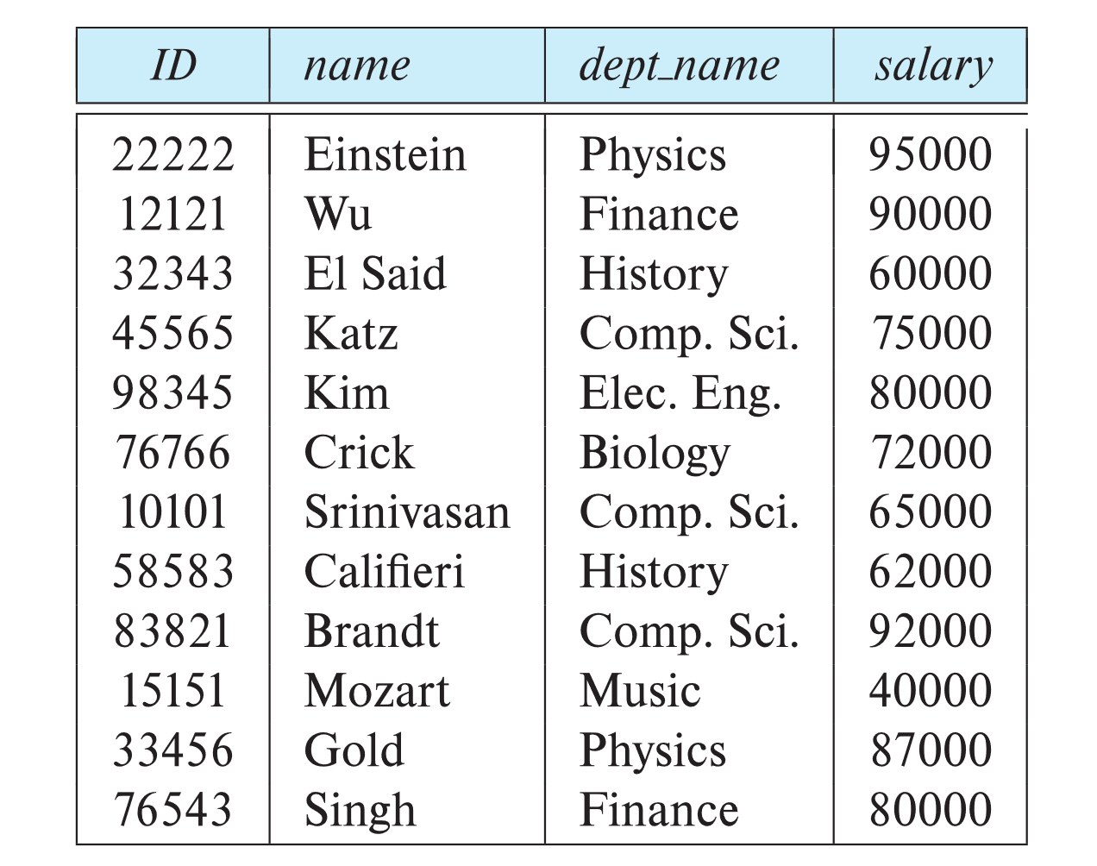
Database Schema
Database schema -- is the logical structure of the database.
Database instance -- is a snapshot of the data in the database at a given instant in time.
Example:
  schema: instructor (ID, name, dept_name, salary)
  Instance:

Slide 8
Database
A database consists of multiple relations
Information about an enterprise is broken up into parts, with each relation storing one part of the information
instructor
student
advisor

Slide 9
Keys
Let K ⊆ R
K is a superkey of R if values for K are sufficient to identify a unique tuple of each possible relation r(R)
  Example: {ID} and {ID,name} are both superkeys of instructor.
Superkey K is a candidate key if K is minimal
Example: {ID} is a candidate key for Instructor
One of the candidate keys is selected to be the primary key.
  which one?
  Should choose an attribute whose value never, or very rarely, changes.

Slide 10
Foreign Key
A relation schema may have an attribute that corresponds to the primary key of another relation. The attribute is called a foreign key.
Foreign key constraint: Value in one relation must appear in another
  Referencing relation
  Referenced relation
  E.g. dept_name attribute of instructor is a foreign key from Department relation
  Only values occurring in the primary key attribute of the referenced relation may occur in the foreign key attribute of the referencing relation.

Slide 11

Schema Diagram for University Database

Slide 12
Relational Query Languages
Language in which user requests information from the database.
Categories of languages
  Procedural
    The user instructs the system to perform a sequence of operations on the database to compute the desired result
  Non-procedural, or declarative
    The user describes the desired information without giving a specific procedure for obtaining that information
“Pure” query languages:
  Relational algebra (procedural)
  Tuple relational calculus ( non procedural)
  Domain relational calculus (non procedural)
Pure languages form underlying basis of query languages that people use.

Slide 13
Relational Algebra
A procedural language consisting of a set of operations that take one or two relations as input and produce a new relation as their result.
Six basic operators
  select: σ
  project: ∏
  union: ∪
  set difference: –
  Cartesian product: x
  rename: ρ
.

Slide 14
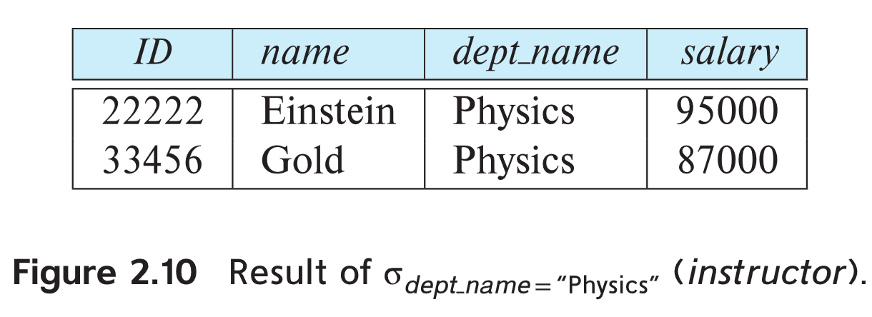
Select Operation
The select operation selects tuples that satisfy a given predicate.
Notation: σ _{p} (r)
p is called the selection predicate
Example: select those tuples of the instructor relation where the instructor is in the “Physics” department.
  Query
  σ _{dept_name=“Physics”} (instructor)
  Result

Slide 15
Select Operation (Cont.)
We allow comparisons using
=, ≠, >, ≥. <. ≤
in the selection predicate.
We can combine several predicates into a larger predicate by using the connectives:
∧ (and), ∨ (or), ¬ (not)
Example: Find the instructors in Physics with a salary greater $90,000, we write:
σ _{dept_name=“Physics”} ∧ _{salary >} _{90,000} (instructor)
The select predicate may include comparisons between two attributes.
  Example, find all departments whose name is the same as their building name:
  σ _{dept_name=building} (department)

Slide 16

Selection of tuples
Relation r
Select tuples with A=B and D > 5
σ _{A=B and D > 5} (r)

Slide 17
Select Operation
Notation: σ _{p}(r)
p is called the selection predicate
Where p is a formula in propositional calculus consisting of terms connected by : ∧ (and), ∨ (or), ¬ (not)
Each term is one of:
<attribute> op <attribute> or <constant>
where op is one of: =, ≠, >, ≥. <. ≤
Example of selection:
σ _{Salary>85000}(Instructor)

Slide 18

Selection of Columns (Attributes)
Relation r:
Select A and C
  Projection
  Π _{A, C} (r)

Slide 19
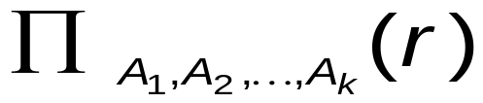
Project Operation
A unary operation that returns its argument relation, with certain attributes left out.
Notation:
where A₁, A₂ are attribute names and r is a relation name.
The result is defined as the relation of k columns obtained by erasing the columns that are not listed
Duplicate rows removed from result, since relations are sets
Example:
∏ _{ID,Salary} (Instructor)

Slide 20
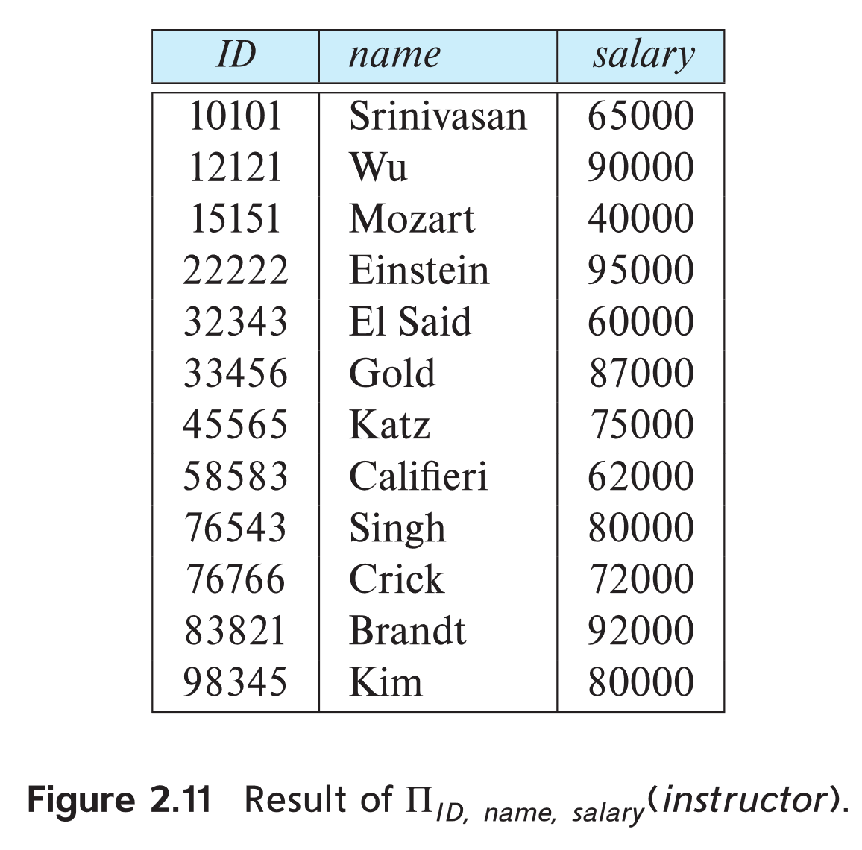
Project Operation Example
Example: Eliminate the dept_name attribute of instructor
Query:
∏_{ID, name, salary} (instructor)
Result:

Slide 21
Composition of Relational Operations
The result of a relational-algebra operation is relation and therefore of relational-algebra operations can be composed together into a relational-algebra expression.
Consider the query -- Find the names of all instructors in the Physics department.
∏_{name}(σ _{dept_name} _{=“Physics”} (instructor))
Instead of giving the name of a relation as the argument of the projection operation, we give an expression that evaluates to a relation.

Slide 22

Joining two relations – Cartesian Product
Relations r, s:
r x s:

Slide 23
Cartesian-Product Operation
Notation r x s
Defined as:
r x s = {t q | t ∈ r and q ∈ s}
Assume that attributes of r(R) and s(S) are disjoint.
(That is, R ∩ S = ∅).
If attributes of r(R) and s(S) are not disjoint, then renaming must be used.

Slide 24
Cartesian-Product Operation
The Cartesian-product operation (denoted by X) allows us to combine information from any two relations.
Example: the Cartesian product of the relations instructor and teaches is written as:
instructor X teaches
We construct a tuple of the result out of each possible pair of tuples: one from the instructor relation and one from the teaches relation.
Since the instructor ID appears in both relations we distinguish between these attribute by attaching to the attribute the name of the relation from which the attribute originally came.
  instructor.ID
  teaches.ID

Slide 25
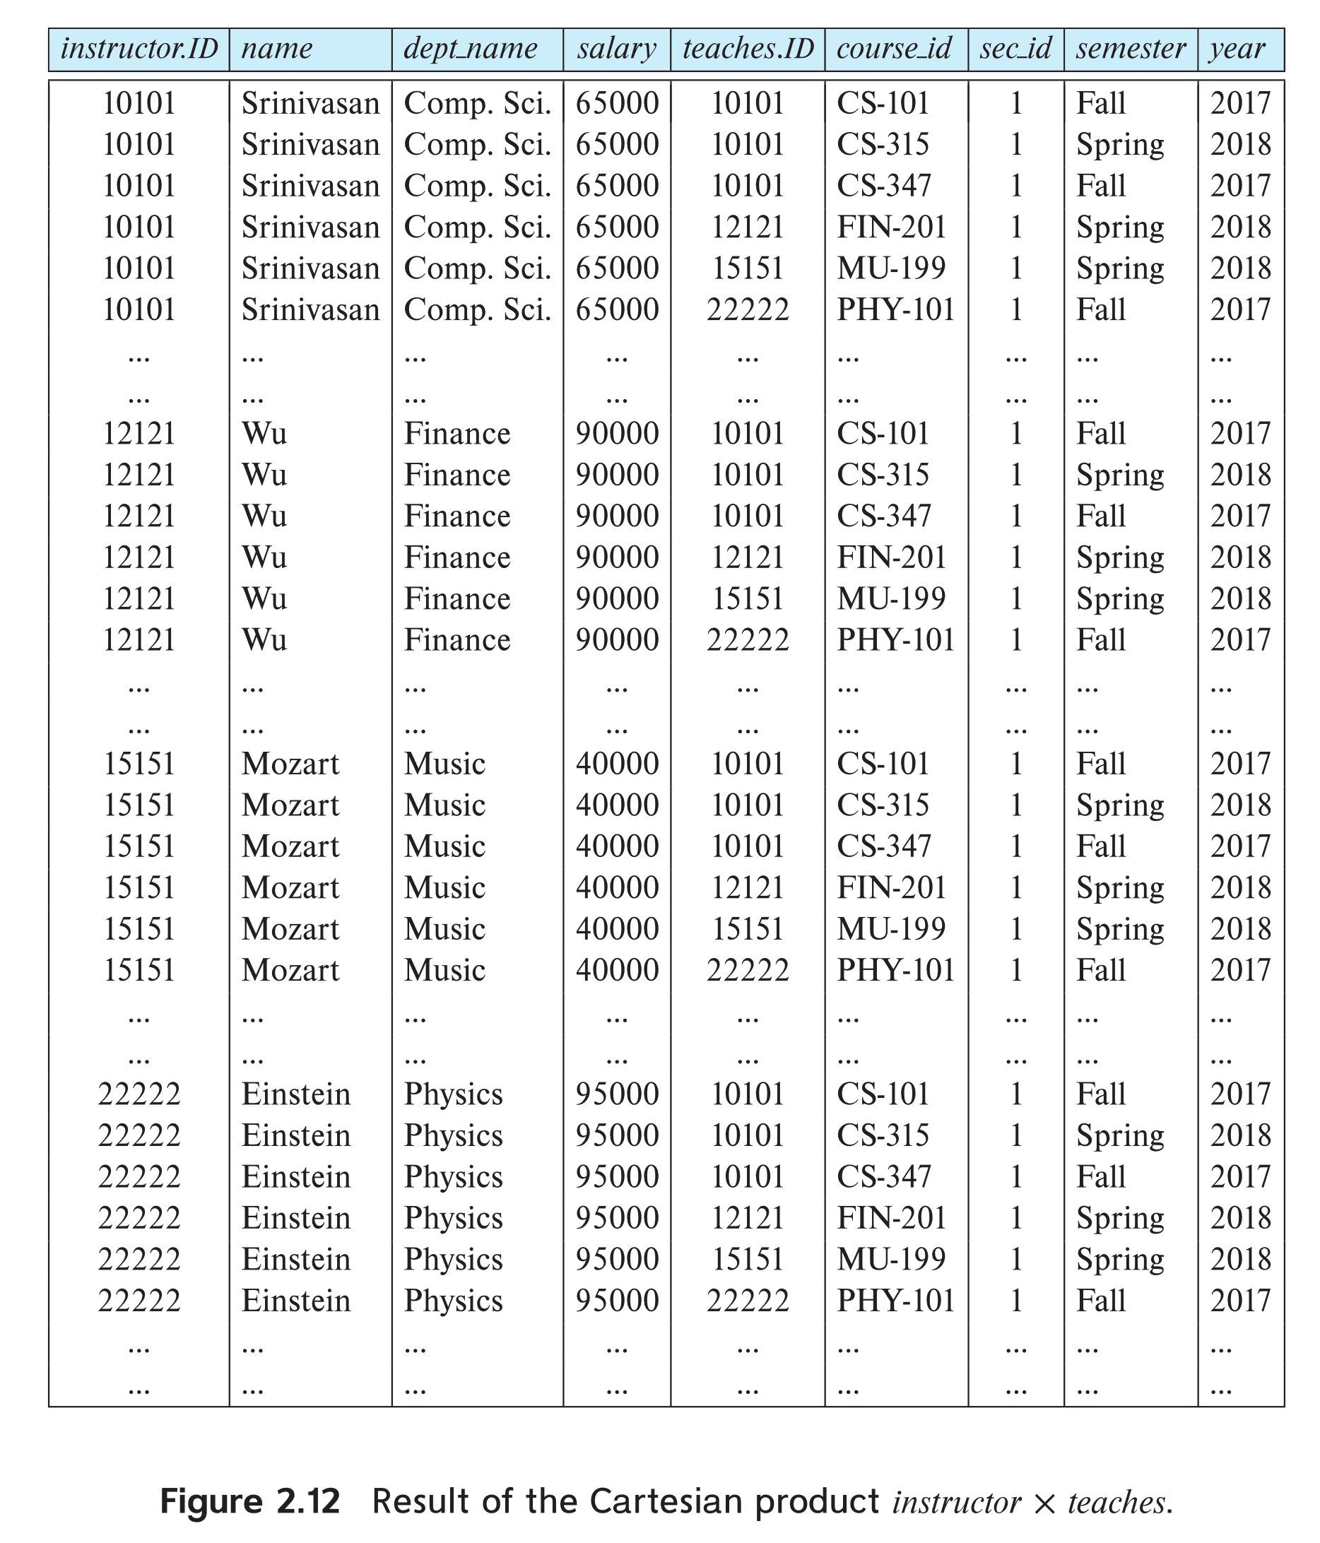
The instructor X teaches table

Slide 26
Composition of Operations
Can build expressions using multiple operations
Example: σ_{A=C}(r x s)
r x s
σ_{A=C}(r x s)
A
B
C
D
E
α
α
α
α
β
β
β
β
1
1
1
1
2
2
2
2
α
β
β
γ
α
β
β
γ
10
10
20
10
10
10
20
10
a
a
b
b
a
a
b
b
A
B
C
D
E
α
β
β
1
2
2
α
β
β
10
10
20
a
a
b

Slide 27
Join Operation
The Cartesian-Product
instructor X teaches
associates every tuple of instructor with every tuple of teaches.
  Most of the resulting rows have information about instructors who did NOT teach a particular course.
To get only those tuples of “instructor X teaches “ that pertain to instructors and the courses that they taught, we write:
σ _{instructor.id = teaches.id} (instructor x teaches )
  We get only those tuples of “instructor X teaches” that pertain to instructors and the courses that they taught.
The result of this expression, shown in the next slide

Slide 28
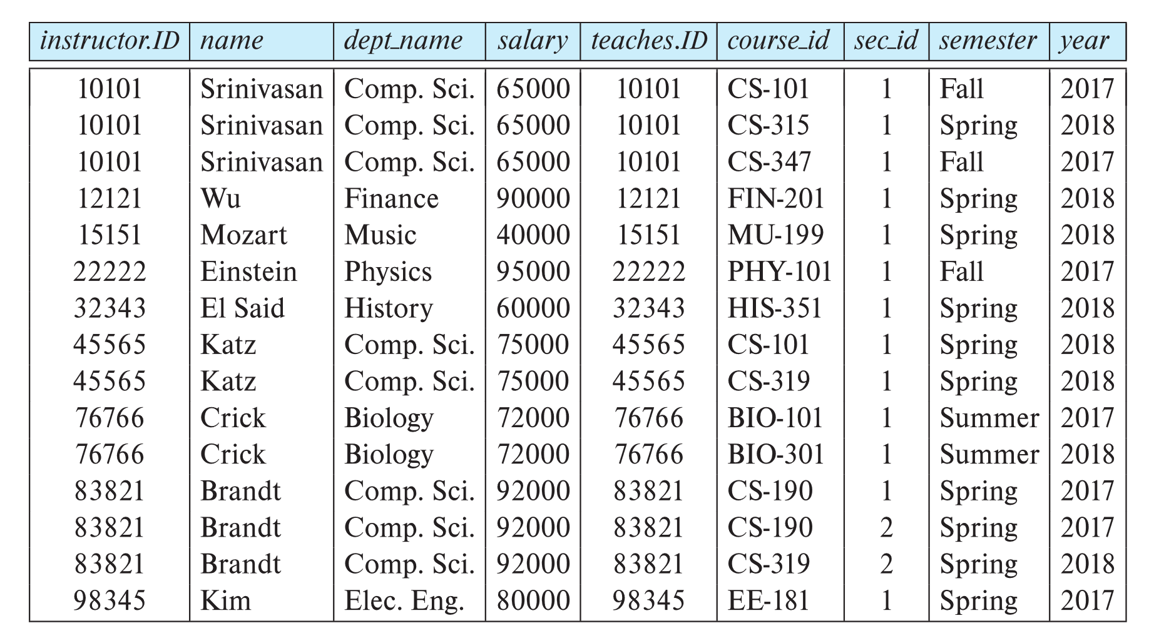
Join Operation (Cont.)
The table corresponding to:
σ _{instructor.id = teaches.id} (instructor x teaches))

Slide 29
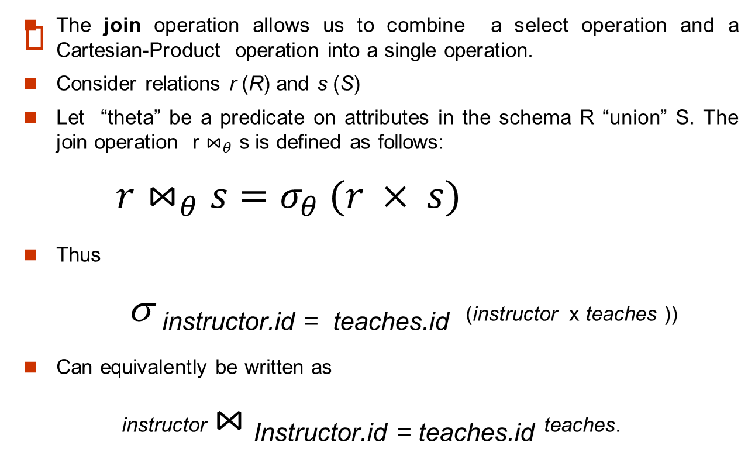
Join Operation (Cont.)

Slide 30

Union of two relations
Relations r, s:
r ∪ s:

Slide 31
Union Operation
The union operation allows us to combine two relations
Notation: r ∪ s
For r ∪ s to be valid.
1. r, s must have the same arity (same number of attributes)
2. The attribute domains must be compatible
(example: 2^{n d} column of r deals with the same type of values as does the 2nd column of s)
Example: To find the names of all the Instructors and the students
∏_{name} (Instructor) ∪ ∏_{name} (Student)

Slide 32
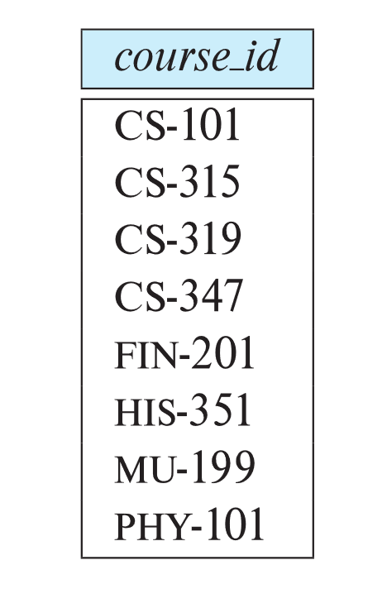
Union Operation
Example: To find all courses taught in the Fall 2017 semester, or in the Spring 2018 semester, or in both
∏_{course_id} (σ _{semester=“Fall” Λ year=2017} (section)) ∪
∏_{course_id} (σ _{semester=“Spring” Λ year=2018} (section))
Result :

Slide 33

Set difference of two relations
Relations r, s:
r – s:

Slide 34

Set Difference Operation
The set-difference operation allows us to find tuples that are in one relation but are not in another.
Notation r – s
Set differences must be taken between compatible relations.
  r and s must have the same arity
  attribute domains of r and s must be compatible
  Example: To find all courses taught in the Fall 2017 semester, but not in the Spring 2018 semester
  ∏_{course_id} (σ _{semester=“Fall” Λ year=2017} (section)) −
  ∏_{course_id} (σ _{semester=“Spring” Λ year=2018} (section))

Slide 35
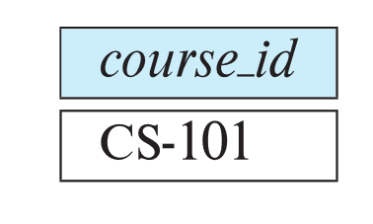
Set-Intersection Operation
The set-intersection operation allows us to find tuples that are in both the input relations.
Notation: r ∩ s
Assume:
  r, s have the same arity
  attributes of r and s are compatible
Example: Find the set of all courses taught in both the Fall 2017 and the Spring 2018 semesters.
∏_{course_id} (σ _{semester=“Fall” Λ year=2017} (section)) ∩
∏_{course_id} (σ _{semester=“Spring” Λ year=2018} (section))
  Result

Slide 36

Rename Operation
Allows us to name, and therefore to refer to, the results of relational-algebra expressions.
Allows us to refer to a relation by more than one name.
Example:
ρ _{x} (E)
returns the expression E under the name X
If a relational-algebra expression E has arity n, then
returns the result of expression E under the name X, and with the
attributes renamed to A₁ , A₂ , …., A_{n} .

Slide 37
The Assignment Operation
It is convenient at times to write a relational-algebra expression by assigning parts of it to temporary relation variables.
The assignment operation is denoted by ← and works like assignment in a programming language.
Example: Find all instructor in the “Physics” and Music department.
Physics ← σ _{dept_name=“Physics”} (instructor)
  Music ← σ _{dept_name=“Music”} (instructor)
  Physics ∪ Music
With the assignment operation, a query can be written as a sequential program consisting of a series of assignments followed by an expression whose value is displayed as the result of the query.

Slide 38
Equivalent Queries
There is more than one way to write a query in relational algebra.
Example: Find information about courses taught by instructors in the Physics department with salary greater than 90,000
Query 1
σ _{dept_name=“Physics”} ∧ _{salary > 90,000} (instructor)
Query 2
σ _{dept_name=“Physics”} (σ _{salary > 90.000} (instructor))
The two queries are not identical; they are, however, equivalent -- they give the same result on any database.

Slide 39
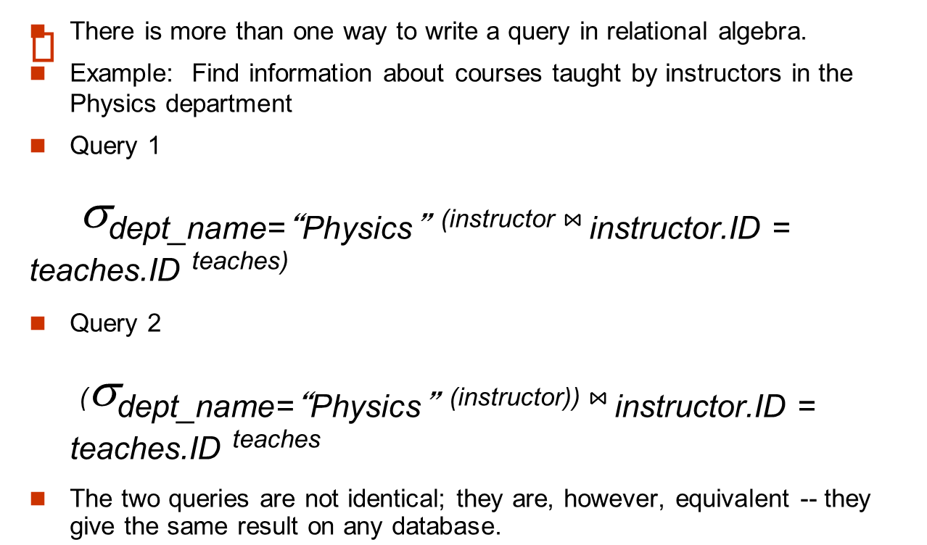
Equivalent Queries

Slide 40

Relational Algebra operations

Slide 41
Banking Example
branch (branch_name, branch_city, assets)
customer (customer_name, customer_street, customer_city)
account (account_number, branch_name, balance)
loan (loan_number, branch_name, amount)
depositor (customer_name, account_number)
borrower (customer_name, loan_number)

Slide 42
Example Queries
Find all loans over $1200
σ_{amount > 1200} (loan)
Find the loan number for each loan of an amount greater than $1200
∏_{loan_number} (σ_{amount} _{> 1200} (loan))
Find the names of all customers who have a loan, an account, or both, from the bank
  ∏_{customer_name} (borrower) ∪ ∏_{customer_name} (depositor)

Slide 43
Example Queries
Find the names of all customers who have a loan at the Perryridge branch.
  Query 1
  ∏_{customer_name} (σ_{branch_name = “Perryridge”} (
  σborrower.loan_number = loan.loan_number (borrower x loan)))
  Query 2
  ∏_{customer_name}(σloan.loan_number = borrower.loan_number (
  (σ_{branch_name = “Perryridge”} (loan)) x borrower )
  )

Slide 44
Example Queries
Find the names of all customers who have a loan at the
Perryridge branch but do not have an account at any branch of
the bank.
∏_{customer_name} (σ_{branch_name = “Perryridge”}
(σborrower.loan_number = loan.loan_number(borrower x loan))
)
–
∏_{customer_name}(depositor)

Slide 45
Example Queries
Find the largest account balance
  Strategy:
    Find those balances that are not the largest
      Rename account relation as d so that we can compare each account balance with all others
    Use set difference to find those account balances that were not found in the earlier step.
  The query is:
∏_{balance}(account) - ∏_{account.balance}
(σ_{account.balance < d.balance} (account x ρ_{d} (account)))

Slide 46
Additional Operations
We define additional operations that do not add any power to the relational algebra, but that simplify common queries.
Set intersection
Natural join

Slide 47
Set-Intersection Operation
Notation: r ∩ s
Defined as:
r ∩ s = { t | t ∈ r and t ∈ s }
Assume:
  r, s have the same arity
  attributes of r and s are compatible
Note:
r ∩ s = r – (r – s)

Slide 48

Set Intersection of two relations
Relation r, s:
r ∩ s

Slide 49

Natural Join Example
Relations r, s:
Natural Join
  r s

Slide 50
Bank Example Queries
Find the names of all customers who have a loan and an account at bank.
  ∏_{customer_name} (borrower) ∩ ∏_{customer_name} (depositor)
Find the name of all customers who have a loan at the bank and the loan amount
  ∏customer_name, loan_number, amount (borrower loan)

Slide 51
Outer Join
An extension of the join operation that avoids loss of information.
Computes the join and then adds tuples form one relation that does not match tuples in the other relation to the result of the join.
Uses null values:
  null signifies that the value is unknown or does not exist
  All comparisons involving null are (roughly speaking) false by definition.

Slide 52
Outer Join – Example
Relation loan
loan_number
branch_name
amount
L-170
L-230
L-260
Downtown
Redwood
Perryridge
3000
4000
1700
Relation borrower
customer_name
loan_number
Jones
Smith
Hayes
L-170
L-230
L-155

Slide 53
Outer Join – Example
Join
loan borrower
loan_number
branch_name
amount
customer_name
L-170
L-230
Downtown
Redwood
3000
4000
Jones
Smith
Left Outer Join
loan borrower
loan_number
branch_name
amount
customer_name
L-170
L-230
L-260
Downtown
Redwood
Perryridge
3000
4000
1700
Jones
Smith
null

Slide 54
Outer Join – Example
Right Outer Join
loan borrower
loan_number
branch_name
amount
customer_name
L-170
L-230
L-155
Downtown
Redwood
null
3000
4000
null
Jones
Smith
Hayes
Full Outer Join
loan borrower
loan_number
branch_name
amount
customer_name
L-170
L-230
L-260
L-155
Downtown
Redwood
Perryridge
null
3000
4000
1700
null
Jones
Smith
null
Hayes

Slide 55
End of the Chapter

